Slide 1
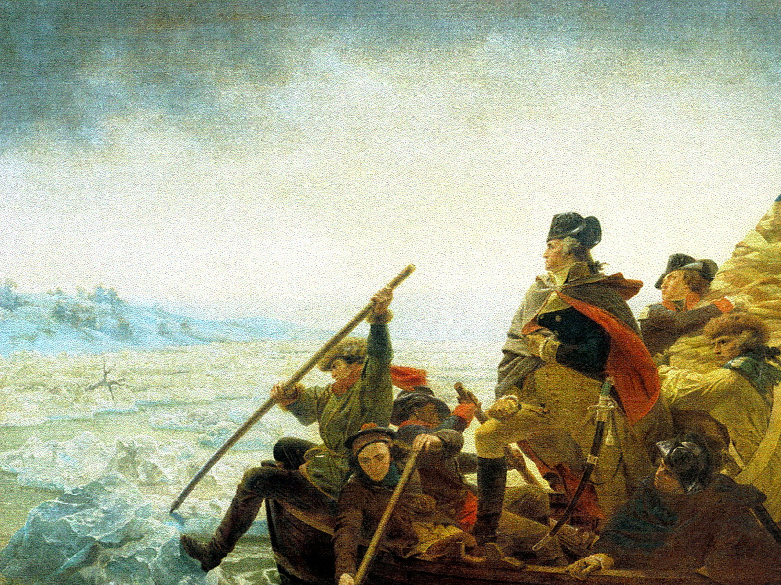
Colonial America The Revolutionary War
and
1585-1776
Plus… The Constitution
Mrs. Quimby Quincy High School US History I Sophomores

Slide 2
English Exploration
The first English explorers were sent by the Tudors – Henry VII and Elizabeth I.
Henry VII sent John Cabot. Cabot landed in Canada, however, the English government did not have enough money to make permanent settlements.
- > Eventually, the Reformation divided Europe, and led to many different religious groups springing up in England.
- > Many of these groups wanted religious freedom.
England was also looking for more trading opportunities. If there were colonies, they would have to buy English goods.
-> The first attempt at an English colony in America was Roanoke, in what is now North Carolina.

Slide 3
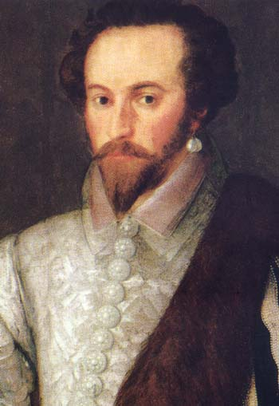
Sir Walter Raleigh
-> The first attempt at a permanent English colony was Roanoke.
- Founded by Sir Walter Raleigh – English explorer and privateer (pirate).
Raleigh settled on an island off the coast of Virginia and North Carolina. He named the colony Virginia after the Queen. She made him a knight.
-> Raleigh had two tries at Roanoke. Though it was the first English attempt at a colony, it was a failure.

Slide 4
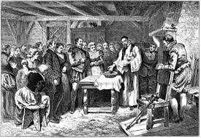
Roanoke
The first try to establish Roanoke happened in 1585. He sent 100 men. They barely survived a hard winter, and decided to go back to England.
The second try was made of families. There were 91 men, 17 women, and 9 children.
One of the women gave birth to the first English-American – a baby girl named Virginia Dare.
- The colony soon ran into problems. The Native Americans were hostile. The colony ran out of food.

Slide 5
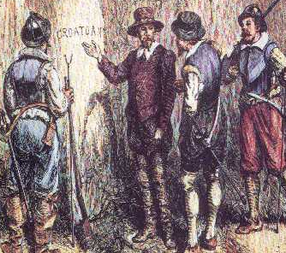
Roanoke
John White (the governor) took some of the men back to England. They were going to get more food and supplies.
However, when White got back, the colony was gone. There was no one left. There were no bodies, no grave stones, just empty houses and a word carved into a tree: “CROATOAN”.
- To this day, no one knows what happened to the colony. Some theories include: cannibalism, hostile natives, starvation, or that the colonists simply moved to a nearby island.

Slide 6
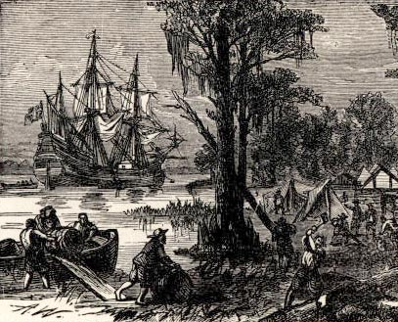
Jamestown
- > After the failure of Roanoke, the next attempt at an English colony was Jamestown, also established in the Virginia colony.
The Jamestown settlers ran into problems immediately.
They settled on swampy land – not good for crops or for buildings, but swarming with mosquitoes.
None of the colonists knew anything about raising crops or livestock.
The Jamestown government could not decide on anything.
> Lawlessness, sickness, and food shortages all affected the colony.
By the end of the first year, of 200 original colonists, only 53 were still alive.

Slide 7
Jamestown - Changes
However, the King didn’t want Jamestown to fail, so he kept sending settlers over.
- > Eventually, Captain John Smith started a trade agreement with the local Powhatan Confederacy, a group of Native Americans. This prevented the colonists from starving.
Thomas Dale drafted a strict code of laws, which kept the colonists in line.
The colonists still almost starved though. During one winter, they had to eat “dogs, rats, snakes, toadstools and horsehides,” and some even dug up corpses to eat the flesh.
In 1614, the colony was saved. John Rolfe started planting tobacco. Trade with Europe saved Jamestown’s economy, and made it finally successful.

Slide 8
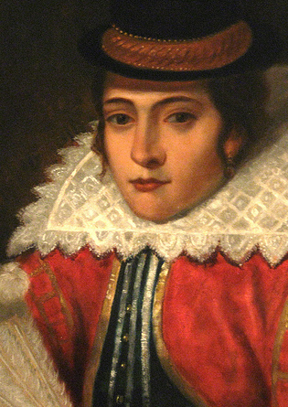
Pocahontas – Not a Disney Movie
In 1623, Captain John Smith told a story about a young Powhatan girl (age 11) who saved him from execution.
Pocahontas was fascinated by the English, and was very friendly.
In return, the English kidnapped her, holding her at ransom for supplies from the Powhatans.
Even after the ransom was paid, the English refused to return Pocahontas.
Eventually, John Rolfe (the same who started planting tobacco in the colony) said he was in love with Pocahontas, and that he was going to marry her.
The two had one son, and moved to England. Pocahontas (now called Rebecca) died before she could return to America. She was 21.

Slide 9
Maryland
-> The next major colony was Maryland, founded in 1632.
Lord Baltimore was a Catholic living in England. At this point, Catholics didn’t have as much freedom as other religions. Baltimore wanted a place where he could practice his religion.
The King gave Baltimore the land. He named the colony Maryland, after the Virgin Mary (important to Catholics).
- > Maryland was the first proprietary colony. This means it was privately owned. Lord Baltimore owned all the land in Maryland. He could run it any way he wanted to.
Though it was established as a Catholic colony, many Protestants settled there, which meant that the religious issues in England were still in the colony.

Slide 10
Massachusetts
In 1620, a group of English colonists landed on the shores of Massachusetts.
They were very off course, but they had run out of beer and needed to land.
-> This group of people were the Pilgrims.
- > They were Puritans, who had broken away from the Church of England and were looking for a place to practice their religion in peace.
The place where they landed was called Plymouth, it had been mapped by John Smith.
To make sure that there was none of the lawlessness that had been a problem in Jamestown, the Pilgrims created a document.
-> The Mayflower Compact set down the laws of the land.

Slide 11
Massachusetts - 2
Plymouth faced problems, too.
A plague wiped out all but 50 settlers. The surviving Pilgrims almost starved.
A Native American called Squanto spoke English. He showed the Pilgrims how to plant food properly, and what plants were safe to eat.
Squanto helped the Pilgrims negotiate a treaty with the Wampanoag people nearby. With the Wampanoag’s help, the Pilgrims survived.
- > Soon, other Puritans saw the success of Plymouth, and joined the Massachusetts Bay Company, which funded settlement in Massachusetts. By 1643, there were 20,000 people in Massachusetts.

Slide 12
Other English Colonies
Rhode Island: Roger Williams, Anne Hutchinson and other “dissenters” who were banished from Massachusetts settled in the more liberal Rhode Island.
Connecticut: Groups of Puritans who wanted more land for livestock moved to Connecticut. They wrote the first official state constitution. The CT settlers ran into problems with local Pequots and Mohegans. The settlers wiped out most of the Pequots, and sold many into slavery to other Native American groups.
New Hampshire and Maine: Maine remained technically a part of Massachusetts until 1820. New Hampshire became a colony in 1677.
New Netherlands/New York: Originally settled by the Dutch, New York was seized by English agents. The King wanted the middle/southern colonies to be connected to the Northern ones. England won the land. New Jersey was settled soon after.

Slide 13
Other English Colonies
Pennsylvania & Delaware: William Penn was given land in the New World to re-pay a debt. He established a Quaker colony in PA. Later, Delaware would split off.
North Carolina: North Carolina developed slowly. Their main economy was based on tobacco.
South Carolina: Originally established in the hopes that it would be good for growing sugarcane. The sugarcane crop failed, and South Carolinian economy became based on the fur trade and slave trade.
Georgia: Georgia was settled as an experiment. James Oglethorpe asked the King for land where people who were too poor to make a living in the Carolinas could start over. The colony was very successful, and for the time period, diverse, including Scots, Welsh, Germans, Swiss, Italians, and Portuguese, and Jewish settlers.

Slide 14
French and Indian War - Europe
-> The French and Indian War began in 1754.
The French and English had been at war for almost 50 years before this point. They fought 3 major wars between 1689 and 1748.
Most of the fighting took place in Europe at first. Eventually though, it spilled over into the colonies.
England and France both had colonies in North America.
- > The French had colonies in Canada (New France) and the Southern US (Louisiana).
- >The British had colonies along the east coast of the United States. (13 colonies)

Slide 15
French and Indian War -Causes
-> Causes of the War:
-> By the 1740s, British and French were interested in the Ohio River Valley.
- The French wanted the area because they found that the Ohio River would let them travel south much easier. This was good because it let French settlers travel from Canada (New France) to Louisiana a lot easier.
- The British wanted the area because of the fur trade; and for settlement in new land. The colonies were already getting crowded.

Slide 16
French and Indian War – first conflicts
In order to block the British settlers from getting into the Ohio River Valley, the French built a line of forts from Lake Ontario to the Ohio River.
In response, the British built their own fort. Before they finished though, the French attacked, and took the fort.
- The British asked George Washington to raise an army to get the French out of the Ohio River Valley.
- Washington was not very successful. He had to retreat, and was eventually forced to surrender.
However, he became a hero – he was a good “face for the war”.

Slide 17
French and Indian War - Albany
-> The Albany Conference
Before fighting broke out in the Ohio River Valley, the British government urged the colonies to unite against the French threat.
The colonies also wanted to negotiate a treaty with the local Iroquois. The Iroquois had control of land that the French needed to travel through.
-> In June 1754, colonists met with the Iroquois at the Albany Conference.
-> Results of the Albany Conference
> Iroquois did not become allies with the British colonists, but the Iroquois did say they would be neutral.
> The colonies agreed that Britain should appoint one person in charge of the colonies.
> Resulted in the Albany Plan of Union, which said the colonies needed to unite under one central government. This was Ben Franklin’s idea.

Slide 18
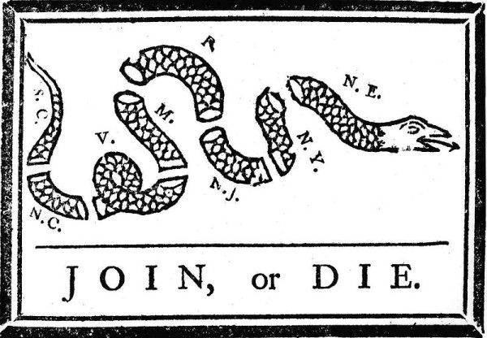
French and Indian War - Sides
Sides of the War
French & Native American groups
The French had many Native American allies, especially the Algonquins. They had worked with the Native Americans in Canada, and they supported French control of the Ohio River Valley.
British Colonists
British Colonists united as one union for the first time.
Eventually the Iroquois would join the British
They wanted access to the Ohio River Valley for land and for the fur trade.

Slide 19
French and Indian War - End
The French and Indian war lasted for two years.
- By 1756, the fighting in America had spread back to Europe, becoming a conflict known as the Seven Years’ War.
Britain’s allies fought the French in Europe, most of the actual British troops were sent to America.
- Because France was distracted by the war in Europe, they stopped focusing as much on the war in America.
- Soon, the Iroquois saw that the French were losing, and no longer wanted to support them.

Slide 20
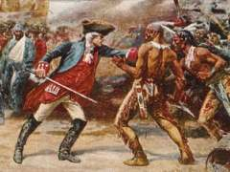
French and Indian War - Treaty
Though Spain joined the war to support the French, it wasn’t enough.
Results of the War:
-> The Treaty of Paris ended the war in 1763.
- France had lost almost all of its land in North America. Canada became a British colony, and all American land east of the Mississippi.
- At this point, Spain gave Florida to Britain in order to maintain control of Cuba.
- To compensate (pay back) Spain for its losses, France gave Spain all of the land west of the Mississippi.

Slide 21
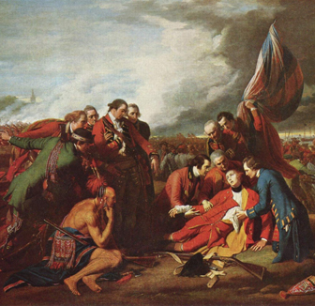
French and Indian War - Results
Gains and Losses
The French
Gained nothing
Lost all land in North America
The Native Americans
Gained nothing
Lost land
Lost lives
Lost their only European ally in North America
The British
Gained land in the Ohio River Valley
Gained land east of the Mississippi
Gained land in Canada
Gained Florida
The Spanish
- Gained land west of the Mississippi

Slide 22
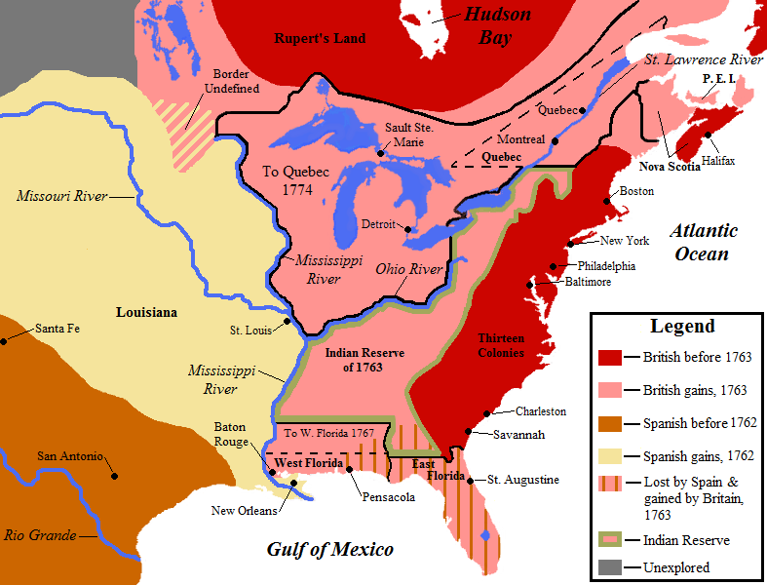
French and Indian War
The French
Gained nothing
Lost all land in North America
The Native Americans
Gained nothing
Lost land
Lost lives
Lost their only European ally in North America
The British
Gained land in the Ohio River Valley
Gained land east of the Mississippi
Gained land in Canada
Gained Florida
The Spanish
Gained land west of the Mississippi

Slide 23
British Acts
Though Britain won the French and Indian War in 1763, there was a new problem.
Britain had spent a ton of money on the war, and was now in a lot of debt.
Britain thought that the Colonies (America) should help them pay off the debt.
The Colonies now had the chance to settle in new lands.
It cost Britain a lot of money to sent British officers and troops to America to fight the French.
The British thought that, since the colonists got more out of the war, they should have to pay for it.
The colonists disagreed. They thought that Britain, as their parent country, should deal with its own debt.
- To pay the debt from the French and Indian War, Britain wanted to raise taxes on the colonies.

Slide 24
British Acts
Thanks to the F&I War, the colonies now had control over the Ohio River Valley, and they wanted to settle there.
However, many Native Americans didn’t want the colonists there.
- The Native American groups (Delaware, Ottawa, Shawnee and Seneca) banded together and said that the land WEST of the Appalachian Mountains and EAST of the Ohio River belonged to Native Americans.
When the colonists started moving over the Appalachians and settling in the land that they had ‘won’ during the F&I War, they were met with aggressive Native Americans, who used lethal force.

Slide 25
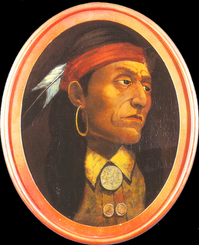
British Acts
-> A coalition of Native American groups (Ottawa, Delaware, Shawnee, Seneca) were led by a man named Pontiac.
Pontiac wanted to make sure that he, and the groups he controlled, were not pushed around by the colonists.
-> Pontiac said that, if any colonists crossed the Appalachians, they would be killed. He made good on his promise.

Slide 26
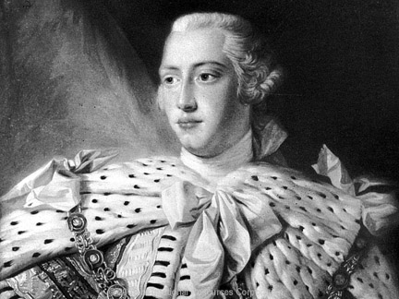
British Acts
- > In October of 1763, King George (Britain) issued the Proclamation of 1763.
- > This Proclamation said that the colonists could not settle WEST of the Appalachian mountains without permission from the British government.
Britain did not want to limit the colonists, but Britain couldn’t think of a better way to deal with Pontiac’s threat, and wanted to protect the colonists.
However, the Proclamation made many colonists upset. They had fought a war for access to the land, and they wanted to expand.

Slide 27
British Acts
- While the Proclamation of 1763 was making western farmers angry, there were also new laws on the east coast, making merchants angry.
- > George Grenville was prime minister of Britain. He wanted to crack down on smuggling, so that he could tax imports and exports, and bring down British debt.
These new taxes just made the colonists want to smuggle more, to avoid paying the customs tax.

Slide 28
British Acts
-> Sugar Act - 1764:
George Grenville introduced the American Revenue Act, aka the Sugar Act.
- > The Sugar act increased taxes on sugar and molasses imported from other countries.
This was to encourage the colonists to buy sugar made in the southern colonies, and produced in Britain.
- This also made the punishment for smuggling even more strict – saying that smugglers were “guilty until proven innocent”.
-> This is the first time people started becoming angry about “Taxation without Representation”.
The colonists had no votes in Parliament, and so could not give their say as to what they thought about the taxes.

Slide 29
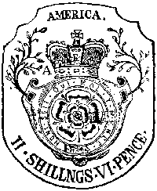
British Acts
-> Stamp Act - 1765:
- > The Stamp Act required special stamps to be placed on legal documents, in order for them to be recognized.
- This included newspapers, wills, licenses, diplomas, birth certificates, and marriage licenses.
The British had taxed trade before, but this was the first tax directly placed on the colonists.

Slide 30
British Acts
Reaction to Stamp Act
Isaac Sears (CT) started the Sons of Liberty, which became very popular as a way to protest the British Acts.
- > In October 1765, representatives from 9 colonies met at the Stamp Act Congress, and wrote the Declaration of Rights and Grievances, which argued that Parliament did not have the right to tax the colonies.
At first colonists ignored the Stamp Act. Then they actively boycotted it – not buying stamped materials.
In response to the boycotts, Parliament passed the Declaratory Act.
>The Declaratory Act said Parliament did have the power to pass any laws it wanted in the colonies.

Slide 31
British Acts
-> Townshend Acts - 1767
The Townshend Acts were enacted by Charles Townshend. They included:
- Revenue Act 1767: Put new taxes on glass, lead, paper, paint, and tea.
- > Gave writs of assistance to Customs Officers. These were search warrants that worked on any home or ship, and never expired.

Slide 32
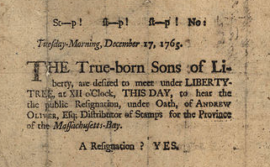
British Acts
American Reaction:
- Sons of Liberty & Daughters of Liberty created to organize protests and boycotts, and to find ways around the taxes.
Virginia passed Virginia Resolves saying that only the Virginian government (House of Burgesses) had the right to tax Virginians.
- This led to a boycott of British goods in Virginia, which spread throughout the colonies.

Slide 33
The Boston Massacre
To enforce the British acts, Britain began sending more and more soldiers into the colonies.
1,000 troops were sent to Boston to “maintain order”.
March 5, 1770, a crowd of colonists threw snowballs and rocks at a British soldier. The soldier called for help.
A squad of British soldiers came to help him. Soon, there was a mob. British soldiers fired into the crowd.
The first dead was Crispus Attucks. Two others died later, and 6 more were wounded.

Slide 34
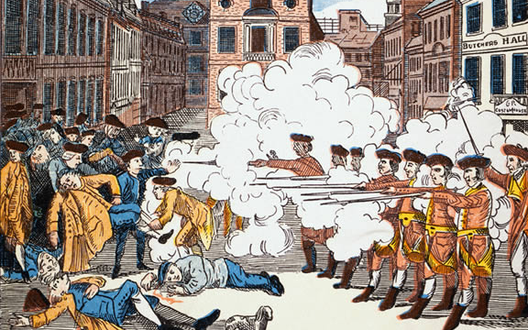
The Boston Massacre
This became known as the Boston Massacre.
News of the “Massacre” spread through the colonies, which started to stir up the colonists even more.
Paul Revere, a silversmith and engraver – created an image that was spread throughout the colonies.
The British Parliament was so worried about a revolution starting that they repealed all of the taxes, except for one – a tax on tea.

Slide 35
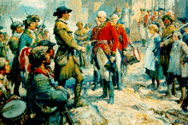
British Response
- In response to the negative press in the colonies following the Boston Massacre, the British government decided to repeal the Townshend Acts.
This ended the crisis in the colonies for a few years.
However, in the spring of 1772, several new policies were introduced, for the same reasons – to cut down on smuggling, build the colonial economy, pay back debt etc.
One of these new policies was to try to reduce smuggling.
The British tried to reduce smuggling by sending their own ships to patrol colonial waters.

Slide 36
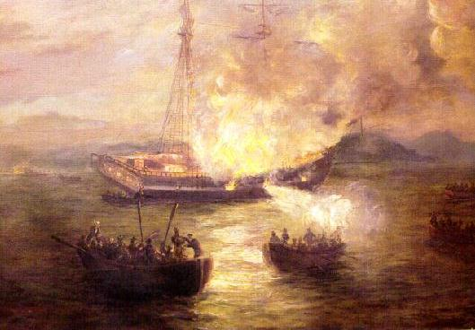
The Gaspee Affair
One of the ships sent to patrol North American waters was called the Gaspee.
-> The British ship Gaspee patrolled Rhode Island. Many Rhode Islanders hated the captain of the Gaspee. The captain searched ships without a warrant, and would come ashore and seize food without paying for it.
In June of 1772, the Gaspee ran aground – getting stuck on high ground.
-> 150 colonists seized the ship and burned it.
This outraged the British. They sent a commission to investigate – taking suspects to England for trial.

Slide 37
The Gaspee Affair
The Rhode Islanders were upset and angry.
They thought that being brought to England for trial violated their right to a trial by a jury of their peers.
The people in England didn’t know them – they weren’t really their “peers”.
Rhode Island wrote to other colonies, asking for advice.
- Thomas Jefferson came up with an idea.
- He suggested that each colony create a committee of correspondence to communicate to other colonies.
- These committees were set up to help colonies talk to one another about British activities.
- They also served to unify the colonies against a common enemy, and to allow colonial leaders to coordinate their plans to resist the British.

Slide 38
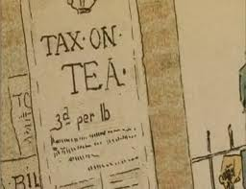
The Boston Tea Party
By 1773, the British Parliament was under new management.
Lord North decided to help the British East India Company – a company that was almost bankrupt.
The British East India Company was corrupt, and their tea was very expensive. Colonists preferred cheaper, easier to get, Dutch tea.
- To help the British East India Company, Lord North passed the Tea Act.
- This act removed many of the taxes on British tea – making it cheaper to buy than Dutch tea.

Slide 39
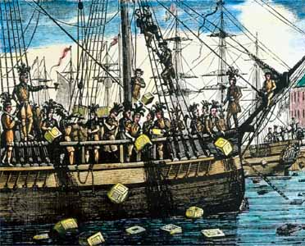
The Boston Tea Party
- The Tea Act also let the British East India company to sell directly to shop-owners – taking business away from American merchants.
It enraged colonists. Many people thought it was the first step to drive Americans out of business, and replace them with British companies.
- In October of 1773, the East India Company shipped tea to major American cities, including Boston.
- The committees of correspondence decided the tea should not be allowed to land on colonial shores.

Slide 40
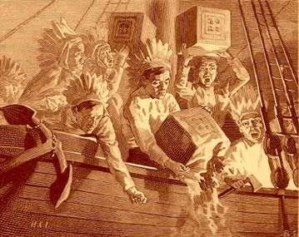
The Boston Tea Party
In New York and Philadelphia, colonists forced the agents of the East India company to leave with the tea.
The most dramatic showdown happened in Boston.
On the night before the customs officers planned to bring the tea ashore, 150 colonists boarded the ships.
The men dumped 342 chests of British tea into the Boston harbor.
This became known as the Boston Tea Party.
It was the last straw for King George III.
He told Lord North, “The time has come for compulsion…”

Slide 41
The Coercive Acts
- In response to the Boston Tea Party, Parliament passed FOUR new laws, called The Coercive Acts.
- These laws were intended to punish Massachusetts.
1. Shut down Boston’s port until the city paid for the tea.
2. All council members, judges, sheriffs, etc. must be appointed by the governor (a British agent) and not elected.
3. The governor is allowed to transfer trials of British soldiers to England, to protect them from American law.
4. Local officials and families must provide lodging for British soldiers, in private homes if necessary.
To enforce these acts, the British moved 2,000 troops into the Boston area, and made British general Thomas Gage as the new governor of Massachusetts.

Slide 42
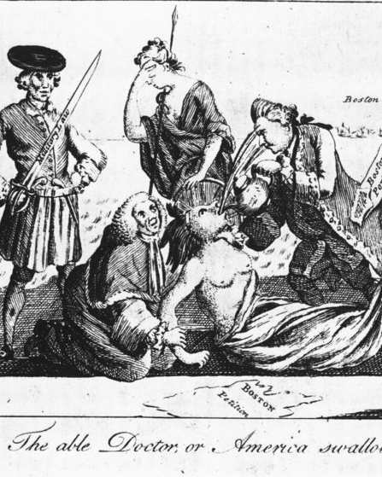
Colonial Reaction
- > The Coercive Acts actually violated many traditional English rights – removing trial by a jury of peers, and a right to privacy in homes.
- > Soon after, Parliament also passed the Quebec Act, which added land to Quebec territory.
Even though the Quebec Act wasn’t directly connected to Boston’s actions, many colonists thought it was an example of Britain trying to take over colonial governments.
- > Together, the Quebec Act and the Coercive Acts are called the Intolerable Acts.

Slide 43
The First Continental Congress
- Following the Intolerable Acts, the colonists began to see British aggression as an act of war.
Virginia declared the British troops in Boston to be a “military invasion”, and called for a meeting. Rhode Island and New York agreed.
- > On September 5, 1774, the First Continental Congress was held.
The goal of this meeting wasn’t to create a Constitution, but rather, to figure out a way to deal with the problem of British oppression.
- > The 55 delegates at the congress represented 12 of the North American colonies, and a wide range of opinion.
- > Some delegates wanted revolution. Others thought that compromise could be reached with the British.
- > This led to the Declaration of Rights and Grievances.

Slide 44
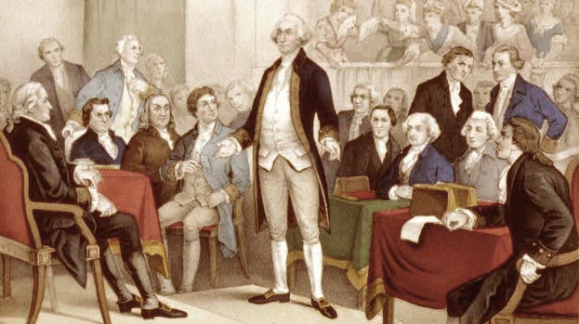
The First Continental Congress
- > The Declaration of Rights and Grievances was not a Declaration of Independence.
- >It said that the colonies were still loyal to the King of England, but it condemned to Coercive Acts.
The Continental Congress also created a plan for every county and town to boycott British goods.
The delegates agreed to hold a second Continental Congress soon.

Slide 45
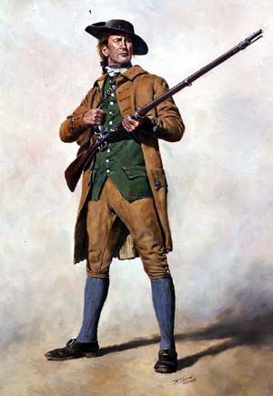
The Revolution Begins
While the first Continental Congress was still meeting, rebellion broke out in Massachusetts.
- > The Massachusetts patriots elected John Hancock as governor - going against the British-appointed General Gage.
- > By October, 1774: In Massachusetts, a full-scale rebellion was now underway.
Minutemen
In 1774, the first minutemen were formed in Concord MA.
This was a special unit, specifically trained to “stand at a minute’s warning in case of alarm”.
All over the colonies, militias (volunteer armies) were forming to take on the British army.
Notes:
45

Slide 46
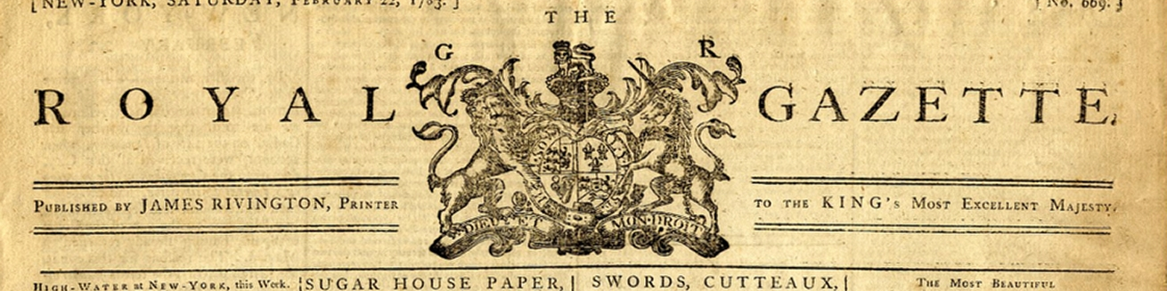
Loyalists v. Patriots
Not everyone agreed with the rebellion.
- > Many colonists did not agree with Parliament's policies, or with the Intolerable Acts, but still felt loyal to the king.
- > These people felt that Americans were British citizens and should still follow English law.
- > These people were called Loyalists or Tories.
Loyalists came from all parts of American societies - not just people who were backed by Britain. Some were government officials, merchants, landowners, but the King was still popular with farmers too.
Notes:
46

Slide 47
Loyalists v. Patriots
Some wanted rebellion and independence…
- > Some colonists thought the British had become tyrants. These people thought that the only way to get a fair government was to rebel.
- > These people were called Patriots or Whigs.
- Like Loyalists, Patriots could be found in all parts of colonial society.
Patriots were strongest in New England and Virginia.
Loyalists were strongest in Georgia, the Carolinas, and New York.
However, states were split. Even in some families there could be patriots and loyalists.
The American Revolution was not just a war between the British and the Americans. It was also a civil war between Patriots and Loyalists.
Notes:
47

Slide 48
Lexington and Concord
- > The first official battle of the Revolution was at Lexington and Concord in April 1775.
- The British government sent General Gage to arrest John Hancock and the colonial government of Massachusetts (called Massachusetts Provincial Congress)
On April 18th, 700 British troops set out for Concord.
They didn’t know where the Congress was located, but they knew that Concord had the militia’s supply depot.
On their way to Concord, the British took a road past the town of Lexington.
Notes:
48

Slide 49
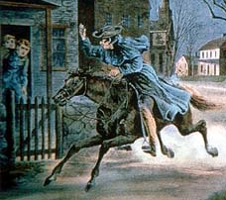
Lexington and Concord
- > Patriot leaders heard about the British troops heading to Concord. The Patriots sent Paul Revere, William Dawes, and Dr. Samuel Prescott to warn Concord.
Before the riders left, Revere told Robert Newman to put lanterns in the Old North Church - a high point that the riders would be able to see. When Newman found out how the British were coming, he hung two lanterns.
Revere reached Lexington and warned people about the coming British.
- > A British patrol caught Revere and Dawes, but Prescott managed to reach Concord in time to warn the people there, and give them time to defend themselves.
Notes:
49

Slide 50
Lexington and Concord
> On April 19, British troops arrived in Lexington.
> 70 minutemen were waiting, lined up on the village green.
The British ordered the minutemen to disperse.
Seeing that they were outnumbered, the minutemen started to retreat.
- > As they were backing up, a shot was fired. This shot was the first shot of the Revolutionary war. It is now called “The shot heard ‘round the world.” No one knows who fired it.
The British thought the shot was fired by the Patriots, and opened fire on them - killing 8 and wounding 10.
The Patriots were angry - they thought the initial shot had been fired by the British, at their backs, while they were retreating.
Notes:
50

Slide 51
Lexington and Concord
> The British went to Concord, but when they go there, they found most of the military supplies were gone.
The British then went to cross the North Bridge on the far side of town, but there they were stopped by 400 militia.
A fight broke out, and the British retreated.
The British headed back to Boston. On the way, Patriots hiding in barns, houses, and trees, fired on them. By the time they reached Boston, the British had lost 99 men, and 174 were wounded.
News of the fighting spread across the colonies.
Militia all over New England raced to help fight the British. By May, militia had surrounded Boston, trapping the British army inside.
Were the battles at Lexington and Concord a success or failure?
Notes:
51

Slide 52
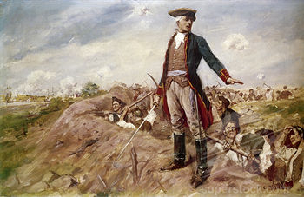
Battle of Bunker Hill
> During the Second Continental Congress, the Congress officially “adopted” the militia that had surrounded Boston. It was now called the Continental Army, and George Washington was made general.
Before Washington could get to his new command, the British sent reinforcements to Boston.
The Continental Army was warned in advance, and dug into a hillside. When the British showed up, they had to fight an uphill battle.
> The Battle of Bunker Hill was a huge victory for the Patriots. It showed the colonists could stand up to the British.
Don’t fire until you see the whites of their eyes!
William Prescott
Notes:
52

Slide 53
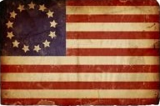
Independence
By 1776, opinions had changed. Patriot leaders now didn’t want peace with Britain - they wanted independence.
As a last-ditch effort, the Continental Congress sent an Olive Branch Petition to King George III, to try to come to a peaceful agreement.
King George III turned it down - the colonists had recently attacked Quebec, trying to get the French to rebel, too. George III said the colonists and British were now, “open and avowed enemies.”
Now cut off from Britain, the colonists began to act more like an independent government. They created a Navy, and Marine Corps, and started raiding British ships.
Notes:
53

Slide 54
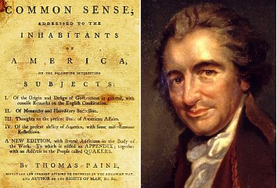
Common Sense
> In January 1776, Thomas Paine wrote Common Sense, a pamphlet talking about how the British government was corrupt, and that George III was a tyrant.
Three months later, 100,000 copies had been sold. More and more colonists wanted independence.
In early July, a committee including John Adams, Ben Franklin, Roger Sherman, and Thomas Jefferson submitted a document that Jefferson had written.
- > July 4th, 1776 - The Continental Congress issued this Declaration of Independence, stating that they were now the United States of America.
Notes:
54

Slide 55
Valley Forge
> During the winter of 1777-78, the Continental Army faced huge problems, especially at Valley Forge.
> The army lacked food, clothing, and other supplies.
“Our troops are in general almost naked and…in starving condition. All my men except 18 are unfit for duty for want of shoes, stockings, and shirts…Poor Jack has…made up his blanket into a vest and breeches. If I did not fear [freezing], I should be tempted to do the same”
Colonel Henry Livingston
Valley Forge was one of the darkest hours in the war for the patriots. Many colonists worried that they would lose the war.
Notes:
55

Slide 56
The Opposing Sides
Colonial Advantages
Fighting on home ground
Good decisions by generals
Fighting for rights, freedoms
French alliance
Colonial Disadvantages
Untrained soldiers
Small army
Food and ammo shortages
Weak and divided central government.
British Advantages
Well-trained, well-supplied army and navy
Plenty of resources
Strong central government
British Disadvantages
Fighting in unfamiliar, hostile territory
Fighting far away from Britain and reinforcements
Troops indifferent - many didn’t care if they won or lost.
Notes:
56

Slide 57
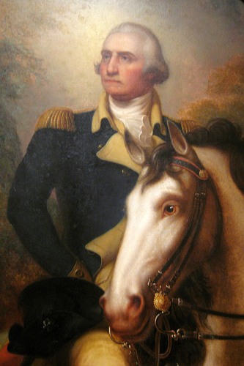
War Spreads
> One important British leader was General Howe. He thought the British could win quickly if they did 2 things.
> 1. Build up British troops in New York (separating New England from the southern colonies)
> 2. Convince colonial leaders to join the British in return for a pardon.
The colonial leaders knew that Howe didn’t have the authority to pardon them, and didn’t fall for it.
However, they knew they had to defend New York.
Washington and the Continental Army were sent to defend New York City.
Notes:
57

Slide 58
War Spreads
> Washington and the Continental Army lost the battle for New York. The British captured New York City and used it as their headquarters for the rest of the war.
Next, Washington expected the British to follow, and continue to fight the Continental Army.
Instead, the British moved south, aiming to take Philadelphia, where the Continental Congress was meeting.
Washington and Co. managed to beat the British to Philadelphia.
The British were forced to hunker down in New Jersey for the majority of the winter months.
Notes:
58

Slide 59
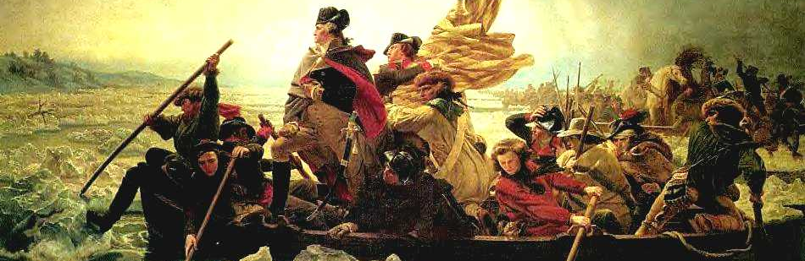
War Spreads
> Washington wanted to attack the British when they weren’t expecting it…and no one expected an attack during the winter.
> Washington and Co. crossed the Delaware river on December 25, 1776.
Washington had two minor victories in New Jersey, which were great for morale.
Notes:
59

Slide 60
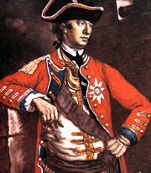
War Spreads
In spring of 1777, Gen. Howe planned to attack and conquer Philadelphia.
This is where the Continental Congress was located. Howe figured - if he took over the city, and held the Congress hostage, he would have a huge advantage.
Howe technically succeeded, but the Congress escaped.
Notes:
60

Slide 61
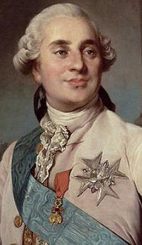
France Joins the War
> September, 1776, Ben Franklin and others were sent to France to ask for troops.
Both France and Spain had secretly been sending money and supplies to the United States already, but the US wanted a formal alliance.
A victory at Saratoga made France realize that the colonists could win the war.
Louis XVI of France agreed to send money, generals, and supplies to the U.S.
-> In 1778, France became the first country to recognize the United States as an independent country from Britain. France also became an ally with the U.S.
Spain later joined the war too, but as an ally of France (not of the U.S.)
Notes:
61

Slide 62
Southern Campaign
> Major battles were also fought in the southern U.S.
After defeat at Saratoga, the British started a campaign in the south. This is where the British thought they had the most support from Loyalists/Tories.
- > Gen. Cornwallis was now in charge of the British army.
The British were successful at first. Cornwallis had major victories at Charles Town and Savannah.
However, the British ran into problems with the colonial militia.
- > The southern militia (led by General Nathanial Greene and Francis “Swamp Fox” Marian) became famous for their guerilla warfare.
They attacked British camps and supply wagons, while staying hidden. This method was very successful. The British gained no more ground in the south.
Notes:
62

Slide 63
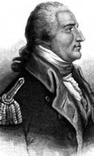
End of the War
Cornwallis thought he could still win the war if he took Virginia, and stopped French and colonial troops from going south.
Cornwallis’ army joined forces with one led by Benedict Arnold. They began to conquer Virginia.
However, Cornwallis was stopped by a large American force, and made to retreat to Yorktown. The battle of Yorktown was the beginning of the end for the British.
Benedict Arnold
Arnold was born in CT. He had to drop out of school because his parents couldn’t afford it.
Arnold joined the military. He was forced to join with the Green Mountain Boys (a VT militia) who constantly mocked him.
Arnold followed Gen. Washington's commands exactly, taking land in Quebec, leading attacks in Connecticut etc.
However, Arnold got NO respect, NO reward, and was even court-martialed. He turned traitor and joined the British.
Notes:
63

Slide 64
End of the War
>Cornwallis’ retreat allowed Washington to regroup.
The previous year, 6,000 French troops had landed in New York. Washington decided to meet the French there.
At this point, French general Rochambeau found out that a French fleet was heading toward New York from the Caribbean.
- Washington heard this and decided instead of fighting the British in New York, he and Rochambeau would go to Yorktown and defeat Cornwallis at Yorktown.
- > At the Battle of Yorktown, the British were attacked over land by the French and Americans, and prevented from getting supplies by the French fleet. Cornwallis gave up.
- > The British surrendered on October 18, 1781.
Notes:
64

Slide 65
End of the War
> The war officially ended with the Treaty of Paris (1783)
This stated officially that the British recognized the United States of America as an independent country.
The borders of America were set as the east coast of North America and the Mississippi River in the west.
America had successfully gained its independence, but now it needed a government.
Notes:
65

Slide 66
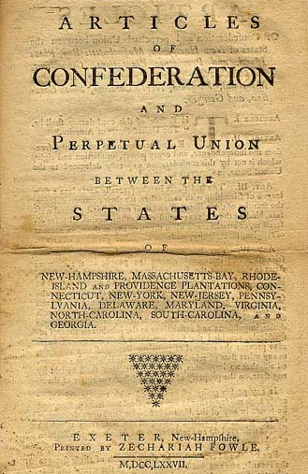
Articles of Confederation
Even before independence was officially declared, the Continental Congress realized the colonies needed to be united under a central government.
- In November 1777, the Continental Congress adopted the Articles of Confederation as this plan of government.
This was a plan for a loose union of states under the authority of Congress.
Notes:
66

Slide 67
Articles of Confederation
DO NOW!!!
Take a few minutes and review your document. Create a list of at least FIVE problems or issues you found with the Articles of Confederation.
KEEP this list. We’ll need it for a class activity on Monday.
Notes:
67

Slide 68
Articles of Confederation
Activity!
Take a few minutes and review your homework. You should have a list of at least FIVE problems or issues you found with the Articles of Confederation.
Pair up with a partner, and answer the following questions:
1. Were there any issues you had in common?
2. Are there any that were similar, and can be combined?
Choose the 3 MOST IMPORTANT of your combined 10 issues.
Together, brainstorm how you would fix these problems. What would you change, or include instead?
You must write down your brainstorm. It will be graded for participation and effort.
Be prepared to discuss!
Notes:
68

Slide 69
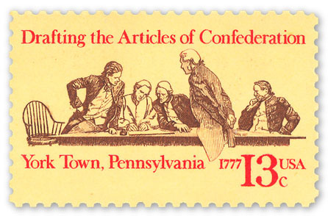
Articles of Confederation
The Articles of Confederation established a very weak central government.
The 13 states had spent years fighting for their independence. They did not want to give up their new independence to a federal government.
- Many people in the states were worried that if the new government was given too much power, it would be no better than living under England.
Because so many people worried about a tyrannical government, Congress was only given very limited power.
Notes:
69

Slide 70
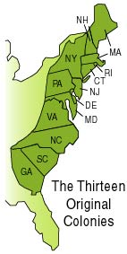
Articles of Confederation
-> Under the Articles, once a year, each state would select a delegation to send to the Capital.
-> This loose group called the Confederation Congress was the entire government of the United States.
There were no separate branches of government.
Aside from this one annual meeting, the states governed themselves pretty much independently.
- What problems could this lead to?
Notes:
70

Slide 71
Articles of Confederation
-> The Confederation Congress only had very limited power. It could…
-> Declare war
-> Raise armies
-> Sign treaties
-> The Confederation Congress could not…
-> Impose taxes on anyone or any state.
-> Regulate trade in the colonies or internationally. Trade was given to the states.
Why would this be a problem?
Notes:
71

Slide 72
Articles of Confederation
Because the Confederation Congress couldn’t raise money with taxes, the government had to find a different way to pay off debt.
To do this, the US government decided to sell land that the US now controlled - West of the Appalachians and east of the Mississippi River.
Later, Congress passed the Northwest Ordinance, which explained how the western territories would be governed. This included laws about slavery, how to elect a territorial government, and how the territory could become a state.
The Confederation Congress was also successful in trade negotiations - making treaties with Holland, Prussia, France, and Britain.
Notes:
72

Slide 73
Articles of Confederation
Although the Confederation Congress had two major successes - creating treaties and organizing western settlement - it had huge problems.
Problems with trade:
= States all controlled their own trade.
= Some states made people pay huge duties to transport goods across their borders.
= Each state started acting like its own country with regard to trade.
Problems with Diplomacy:
= American planters and traders had borrowed money from Britain before the war. Britain expected these debts to be repaid. However, Congress had no power to make Americans pay the British back.
- This led to a huge recession.
Notes:
73

Slide 74
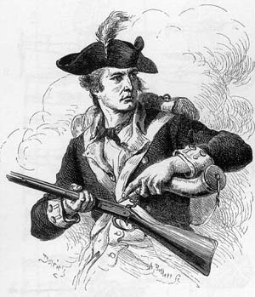
Articles of Confederation
- In 1786, Shays’s Rebellion erupted in Massachusetts.
- The rebellion started when the government of Massachusetts decided to raise taxes instead of issuing paper money to help pay off debt.
Because of this, farmers rebelled.
Daniel Shays - a former army captain who was now a farmer - became one of the leader.
Shays and 1,200 farmers headed to the MA arsenal to seize weapons and march on Boston. Shays attacked and the militia defending the arsenal opened fire.
This shocked the Confederation Congress, and made them realize they needed a stronger government.
Notes:
74

Slide 75
Articles of Confederation
The Constitutional Convention was called to fix the Articles of Confederation.
Major problems the Convention was trying to fix:
1. Nation-wide recession because there is no way to get money and pay back debts
2. Farmers rebelling because their paper money is worthless, and they have no way to support themselves.
3. No strong, unified government.
4. No judicial branch.
Notes:
75

Slide 76
Constitutional Convention
- Many American leaders were worried about the government. They thought that, without a strong central government, the United States would not survive.
-> People who supported a stronger central government were called nationalists.
-> Important nationalists were George Washington, John Adams, Ben Franklin, James Madison, Alexander Hamilton, and Robert Morris.
Many people didn’t want a stronger or revised government, however, Shays’ Rebellion made people realize that there needed to be some kind of revision.
- In May, 1787, a convention of the states was called, “for the sole purpose of revising the Articles of Confederation.”
Representatives from 12 states attended. Rhode Island didn’t go.
Notes:
76

Slide 77
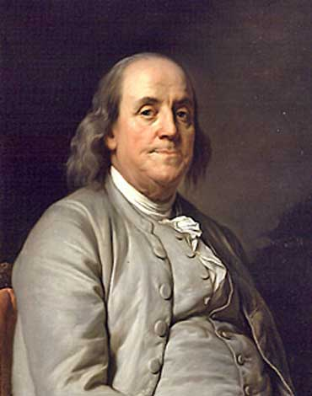
Constitutional Convention
>The Constitutional Convention was held in Philadelphia.
55 delegates came, which included lawyers, governors, members of the Confederation Congress… Thomas Jefferson called it, “an assembly of demigods”.
>At the Constitutional Convention, two major plans for government were introduced: The Virginia Plan and the New Jersey Plan.
Notes:
77

Slide 78
Constitutional Convention
> The Virginia Plan
When the Virginia delegation arrived, they already had a plan to fix the government - written by James Madison.
The plan was to completely scrap the Articles of Confederation and create a new national government.
- The Virginia Plan proposed that the government ought to be split into three branches - a legislative, executive, and judiciary branch.
- > The Virginia Plan also said that the legislature should be divided into two houses.
- > Voters in each state would elect members of the first house. Members of the second house would be elected by the first house.
- > In both houses, the number of representatives would be based on the size of the population in the states.
Notes:
78

Slide 79
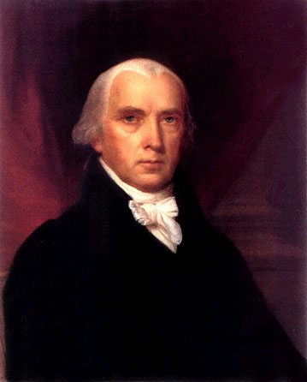
Constitutional Convention
> Problems with the Virginia Plan
Most of the delegates thought dividing the government into three branches was a good idea. Having a separate judicial, executive, and legislative branches made sense.
However, people from the small states were upset that the legislative branch would be based on population only.
- > Many representatives of the smaller states worried that the larger states, with more representation in the legislature, would outvote them.
Notes:
79

Slide 80
Constitutional Convention
> The New Jersey Plan
William Paterson, a delegate from New Jersey, offered a counter-proposal.
- The New Jersey Plan did not abandon the Articles of Confederation - it just modified them to make the central government stronger.
- > Under the New Jersey Plan, there would be only one legislative house, in which each state would be equally represented.
The delegates voted for the Virginia Plan. However, this upset a lot of people from the small states.
The only way to fix this was through compromise…
Notes:
80

Slide 81
Exit Slip
Neither the New Jersey Plan nor the Virginia plan made all of the delegates happy.
Imagine you are a delegate at the Constitutional Convention. Come up with a plan of your own for how the states should be represented in the federal government.
Describe how your plan will make things fair for all states.
Explain how your plan is better than the proposed New Jersey and Virginia plans.
What are some problems/issues that the other delegates might have with your plan? How will you address these if they come up?
Notes:
81

Slide 82
Constitutional Convention
The Connecticut Compromise
In order to modify the Virginia Plan to appease the small states, Ben Franklin was put in charge of a special committee.
Ultimately, Roger Sherman of Connecticut proposed the perfect compromise:
- > The Connecticut Compromise said that Congress (the legislative branch) would be divided into two houses.
The Senate would have the same number of representatives from each state, regardless of size.
> The Senate would have 2 senators from each state.
> The House of Representatives would have representatives from each state based on their population. The larger the state, the more representatives in the House.
The Connecticut Compromise was something everyone could agree on.
Notes:
82

Slide 83
Constitutional Convention
> More Compromises…
The only issue with the Connecticut Compromise was how population would be counted for the House of Representatives.
This caused a split between the Northern and Southern states.
- > The Southern delegates wanted slaves to be counted for population purposes, because this would give their states more representatives.
- The Northern delegates objected, saying that if slaves couldn’t vote, they shouldn’t be counted as citizens of the south.
In the end, the Three-Fifths Compromise was reached.
Notes:
83

Slide 84
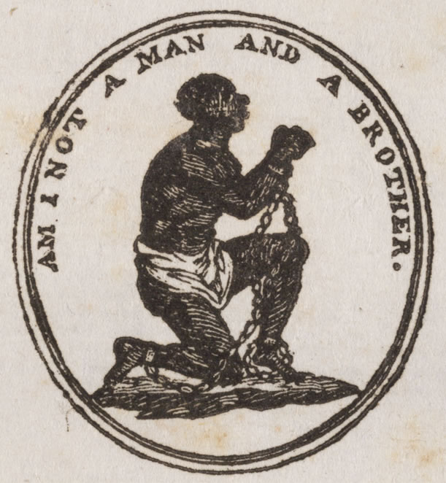
Constitutional Convention
> The Three-Fifths Compromise
- > The Three-Fifths Compromise said that every five slaves would count as three free persons, for the purposes of population and taxation.
This did not fix every issue though.
Many people were against slavery in general, and thought that if slaves were going to be counted for population, then they should also be freed and made citizens.
However, in order for the Convention to move on, however, the Three-Fifths Compromise was agreed upon.
Notes:
84

Slide 85
Constitutional Convention
> Other additions and compromises
> In order to please the delegates from the South, the “Fugitive Slave Clause” was added, which said slaves could be returned to their masters even if they escaped to a free state.
A “Slave Trade Clause” was also included. Because slavery was such a controversial issue, this clause stated that Congress would meet and discuss (and vote on) the slave trade in 1808.
Do you think these were good solutions to the issues of slavery in the United States?
Why did people agree to these compromises and clauses?
Notes:
85

Slide 86
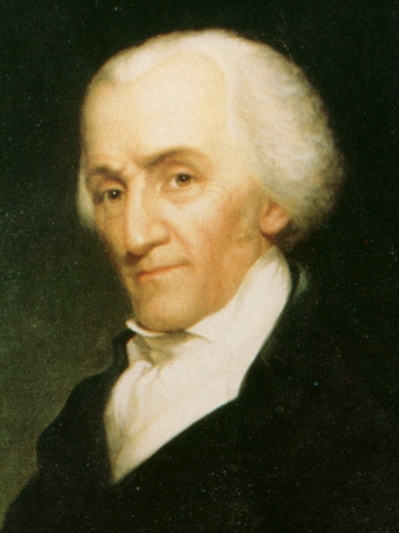
Constitutional Convention
> The Constitution is Signed – September 17, 1787
Not everyone was happy with the finished product of the Constitution.
Ben Franklin said, “I confess that there are several parts of this constitution which I do not at present approve…” However, he signed it anyway.
Elbridge Gerry and George Mason were worried about the lack of a Bill of Rights. They refused to sign the Constitution without the addition.
However, of those present that day, only three people refused to sign.
- BUT… It wasn’t over. The new Constitution now had to be approved by the states.
Notes:
86

Slide 87
Federalists v. Antifederalists
> When the Constitution was finished, people were split into two camps: Federalist and Antifederalist
> Federalist: People who supported the Constitution, and wanted to vote for its ratification.
> Antifederalist: People who opposed (were against) the Constitution, and did not want it to pass.
+ Most Antifederalists were specifically worried by a lack of a Bill of Rights. They thought that, without the rights stated outright, the government would take advantage of people.
+ The Antifederalists also argued that the members of the Constitutional Convention had gone too far – their job had been to re-write the Articles of Confederation, not to create a new government.
Notes:
87

Slide 88
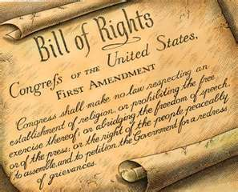
Federalists v. Antifederalists
Antifederalist Concerns cont…
Antifederalists also worried that, with a strong government, power would be concentrated in only a few people – no better than a monarchy.
The Antifederalists started writing about their concerns, publishing pamphlets and newspapers that said how the Constitution was going to ruin the country.
The Federalists had to convince them otherwise.
Notes:
88

Slide 89
Federalists v. Antifederalists
> Federalists believed that a strong central government was key to a strong country.
To counteract the bad press spread by the Antifederalists, the Federalists had to “wage a war in the press” too.
> Alexander Hamilton, John Jay, and James Madison wrote letters to local newspapers.
-> These letters became known as The Federalist Papers.
They went a long way to convince people to ratify the Constitution!
Notes:
89

Slide 90
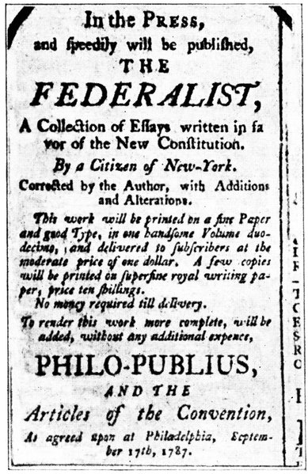
The Federalist Papers
> John Jay, Alexander Hamilton, and James Madison wrote 85 essays and articles total.
Hamilton had the idea to write under a pen name: Publius – an ancient hero who established a republican government in Rome.
The Federalist Papers were highly effective for several reasons, importantly…
> They pointed out the positives of the Constitution, and of a strong central government.
> They ridiculed (made fun of) the Antifederalists for their fears.
Notes:
90

Slide 91
Ratification
The Federalists felt that they had gained ground, and they wanted the states to vote.
- > The states began to debate about whether or not To ratify – approve – the Constitution.
Delaware was the first to approve the document, Pennsylvania followed soon after.
- > In order to be ratified, at least 9/13 of the states needed to approve the Constitution.
In June of 1788, New Hampshire became then ninth state to ratify the Constitution – ensuring a new government for the colonies.
Notes:
91

Slide 92
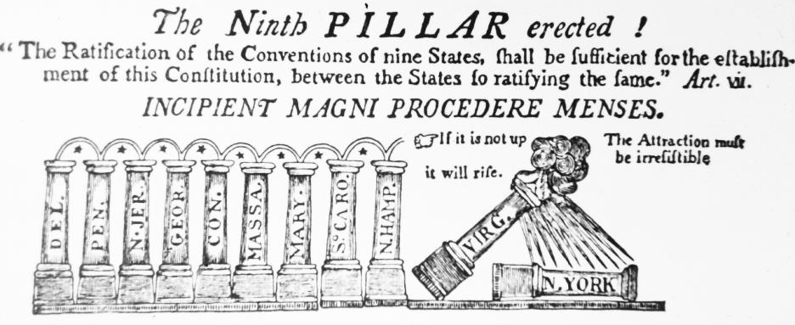
Ratification
This political cartoon was published after New Hampshire ratified the Constitution.
What does it mean? What do the pillars represent? What does it say about Virginia and New York?
If you were an Antifederalist, what would this say to you?
Notes:
92

Slide 93
Confederation v. Constitution
Do Now:
Why is it important for a country to have a strong central government?
How did the Constitutional Convention address problems with the Articles of Confederation?
What was the Virginia Plan?
What was the New Jersey Plan?
What was the Connecticut Compromise?
What was the Three-Fifths Compromise? Why did this cause issues with the delegates?
Notes:
93

Slide 94
The Constitution
As of June, 1788, the Constitution had been ratified and now was the basis of the government of the United States.
The Constitution can be broken down into several parts:
The Preamble: an introduction to the Constitution. The Preamble states the purpose of the document (why it was written)
Guiding Principles of the Constitution: There are four guiding principles of the Constitution which state how the government should be run.
Articles 1, 2, 3: The first three Articles of the Constitution describe the roles of the three branches of government (Legislative, Executive, and Judicial)
Articles 4-7: Describe other issues that the Constitution wants to address – includes state relations, how to add amendments, and how to approve the Constitution.
Bill of Rights: The first 10 Amendments were added to the Constitution on December 15, 1791.
Notes:
94

Slide 95
The Constitution
The Preamble is the introduction to the Constitution – it describes why the document was written, and its goals/purpose.
It states:
“We the People of the United States, in order to form a more perfect union, establish justice, ensure domestic tranquility, provide for the common defense, promote the general welfare, and secure the blessings of liberty to ourselves and our posterity do ordain and establish this constitution for the United States of America.”
Notes:
95

Slide 96
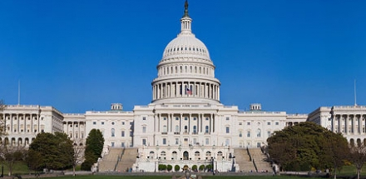
The Constitution - Articles
Articles 1-3 describe the three branches of government.
- > Article 1 describes the legislative branch
- > This article gives Congress the power to make laws.
- > It says that Congress has two parts - the House of Representatives and the Senate.
Thanks to the Connecticut Compromise, the Senate has 2 senators from each state. The amount of Representatives in the House of Representatives is based on the population of each state.
Notes:
96

Slide 97
The Constitution - Articles
Article 1 also says, specifically, what the legislative branch can do.
The Legislative Branch CAN - Make laws - Collect taxes/borrows money - Regulate international trade - Set rules for citizenship - Provide for the country’s defense. Can declare war. - Set up lower courts (lower than supreme courts)
Notes:
97

Slide 98
The Constitution - Articles
-> Article 2 talks about the executive branch.
-> It specifically focuses on the role of the President.
Some of these responsibilities include the power to appoint ambassadors to represent the United States in other countries, as well as to appoint judges to the Supreme Court.
The Executive Branch - Carries out laws created by Congress - Makes treaties with other countries - Appoints ambassadors, other public officials - Leads the armed forces (army, navy, air force etc)
Notes:
98

Slide 99
The Constitution - Articles
-> Article 3 describes the role of the Judicial Branch
Under the Articles of Confederation, there was no Judicial Branch. For the first time, now there would be a nation-wide way to ensure people followed laws, and that these laws were constitutional.
Article 3 specifically describes the role of the Supreme Court.
Other courts (district courts, courts of appeals) were still controlled by the states.
The Judicial Branch - Decides whether laws follow the Constitution - Interprets laws - Decides appeals from lower courts.
Notes:
99

Slide 100
The Constitution - Principles
The Constitution also describes four guiding principles.
These are the general principles - ideas, guidelines - that our country’s government is based in.
The four guiding principles are…
-> Separation of Powers
-> Checks and Balances
-> Limited Government
-> Popular Sovereignty
Notes:
100

Slide 101
The Constitution - Principles
-> Separation of Powers…
Separation of powers describes how the power of the government is split into three different branches.
This means that no one branch has the power of the entire government, and therefore, no one person has the power of the entire country.
Why would the framers of the Constitution want to separate power into three branches?
What were they trying to avoid?
Notes:
101

Slide 102
The Constitution - Principles
The second major principle of the Constitution is checks and balances.
This is related to the idea of separation of powers.
Under this principle, the three separate branches of government each have unique abilities, however, they also can “check” each other.
A “check” is a power that can counteract or un-do the action of another branch.
This prevents one branch from becoming too powerful!
Notes:
102

Slide 103
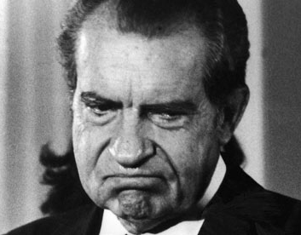
The Constitution - Principles
The third principle of the Constitution is limited government.
This means that even people in the government - even the President - have to follow the laws of the Constitution.
No one is exempt from the law - no matter how powerful they are!
Notes:
103

Slide 104
The Constitution - Principles
The fourth principle of the Constitution is popular sovereignty.
This means that the government is controlled by the people because the people elect the government officials.
Popular – populus – people
Sovereignty – leadership – rule of
Popular sovereignty = the rule of the people
Notes:
104

Slide 105
The Constitution - Articles
The first three articles of the Constitution describe the roles of the three branches of government.
Articles 4-7 focus on different topics:
4. States v. federal government
5. Amending the Constitution
6. How powerful is the Constitution?
7. Process of ratification.
Notes:
105

Slide 106
The Constitution - Articles
Article 4 focuses on the powers of the state vs. the powers of the federal government
Federal government = Government of the whole country, the whole United States.
-> Article 4 specifically focuses on the idea that laws or legal rulings made in one state are valid in all other states.
What is are some areas where states have different laws?
How might this cause problems or issues between states?
Notes:
106

Slide 107
The Constitution - Articles
-> Article 5 explains the process to add amendments to the Constitution.
An amendment is submitted to Congress, and voted on by Congress. In order to be approved, 2/3 of the people in both houses must agree to the amendment.
The amendment is then sent to all of the states.
In order to be approved overall, one of two things need to happen in EACH state.
1. Either the amendment needs to be approved by 3/4 of the people in the state government
2. Or Congress can call state conventions, to make the population vote whether or not to pass the amendment.
In the history of the United States, there have been over 9,000 amendments suggested. Only 27 have been accepted and added to the Constitution.
Notes:
107

Slide 108
The Constitution - Articles
-> Article 6 is simple. It states:
-> “The Constitution is the supreme law of the land”.
This means that every law made in any state has to follow the Constitution. If it is found to be in violation of the Constitution, the law will be made invalid.
It also means that the Constitution overrides any state laws. State governments have to defer to the Constitution.
What issues might this cause?
What happens if a state law is found to be unconstitutional?
Notes:
108

Slide 109
The Constitution - Articles
The final article of the Constitution is article 7.
-> Article 7 describes how the Constitution will be ratified - approved - by the states, in order for it to become law.
This is the article that stated that at least 9 out of the 13 states needed to ratify the Constitution for it to be official.
Review: What was the 9th state to ratify the Constitution?
Notes:
109

Slide 110
The Bill of Rights
-> The first 10 amendments of the Constitution are called the Bill of Rights.
-> These 10 amendments were all passed by 1792 - only a few years after the Constitution was passed.
This helped make the Antifederalists happy, too - now that the rights were written down on paper, they figured it would be hard for the government to take these rights away.
Originally, 12 were proposed, but 10 were passed.
However… people are even now still debating about how these amendments should apply.
Notes:
110

Slide 111
The Bill of Rights
-> Amendment 1= Freedom of Expression
-> This includes… freedom of speech, freedom of religion, freedom of assembly, freedom of petition, and freedom of the press.
-> Other rights are protected under the idea of “symbolic speech”.
Generally speaking, there are virtually no limits to freedom of expression, however, there are some exceptions.
= In schools, freedom of speech can be limited in order to protect other students, and ensure people feel safe.
= In some areas, “hate speech” is not considered to be protected speech, as it is considered offensive and unnecessary.
Notes:
111

Slide 112
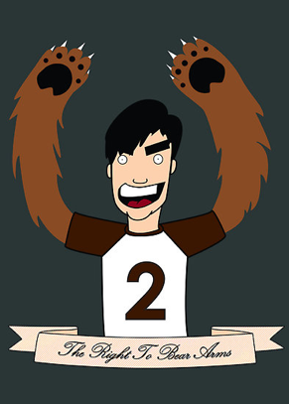
The Bill of Rights
-> Amendment 2= Right to Bear Arms
The second amendment states: “A well regulated Militia, being necessary to the security of a free State, the right of the people to keep and bear Arms, shall not be infringed.”
-> This means that people can own guns, and use them.
-> It also grants states the right to create militias if they need them.
When this amendment was first created, it was for the protection of American citizens, especially those people settling in new land in the Northwest.
There is a lot of controversy about the Second Amendment today, though… what might cause this?
Notes:
112

Slide 113
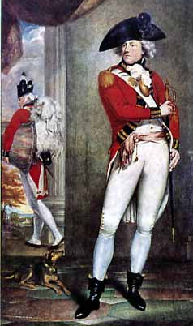
The Bill of Rights
-> Amendment 3= No quartering of British soldiers
The third amendment was created to make sure that something like the Quartering Act could never happen again. It protects American citizens from having to house soldiers in their homes.
Because it is so specific, the third amendment is not really used today. However, because it is a part of the Constitution, it can never be changed!
I wanna stay at your house!
Notes:
113

Slide 114
The Bill of Rights
-> Amendment 4= Protection from Search and Seizure
This amendment ensures that people are protected from unlawful search and seizure.
Because of this amendment, police need one of two things in order to enter your home.
= > A search warrant signed by a judge
= > Probable cause that a crime is being committed right that second.
However, the fourth amendment is different in places like schools. A supreme court decision (New Jersey v. T.L.O.) said that, with probable cause, a teacher, principal, security guard etc. can search a student’s bag or locker.
Notes:
114

Slide 115
The Bill of Rights
Amendment 4= Protection from Search and Seizure
Which of these situations is an example of probable cause?
A policeman pulls over a car for speeding. The inside of the car smells like marijuana. Can the police officer search the car?
A police officer hears a loud argument coming from a home. He knocks but no one answers. Can he open the door anyway?
A police officer is in the neighborhood of a known criminal. Can he search houses in the area looking for the bad guy?
Notes:
115

Slide 116
The Bill of Rights
-> Amendment 5 = Rights in criminal cases
This amendment explains the rights a person has if they are accused of committing a criminal act.
-> It includes: being brought before a grand jury “jury of your peers” to conclude the outcome of the case.
-> It also includes “due process of law”, which makes sure the trial is fair, and both sides are heard.
-> It also includes “the right to remain silent” – protection from self-incrimination.
Notes:
116

Slide 117
The Bill of Rights
-> Amendment 6 = Right to a fair trial
Amendment 6 is linked to amendment 5. They are often put together.
Together, parts of Amendment 6 and 5 are called “Miranda Rights”.
A person has these rights if they are accused of a crime:
Be told of the crime of which he or she is accused.
Be given a speedy public trial before a fair jury, in the state in which the crime took place.
Have a lawyer to argue the case.
Have witnesses appear, by legal force if necessary, to tell the accused person’s side of the case.
Hear and questions what witnesses have to say.
Notes:
117

Slide 118
The Bill of Rights
-> Amendment 7= Rights in civil cases
Amendment 7 talks about the rights someone has if they are accused of a civil (not criminal) act.
-> Unlike a criminal case, if a person goes to civil court, the prosecutor does not need to prove “beyond a reasonable doubt” just that the person is “most likely” responsible.
Civil lawsuits are usually about money, property, or some kind of dispute.
Notes:
118

Slide 119
The Bill of Rights
Amendment 8 = Bails, fines, and punishments
-> Amendment 8 protects someone accused of a crime from unreasonable or extreme bail.
It also ensures that people are treated reasonably well while they are in police custody - that they are given enough food etc.
Notes:
119

Slide 120
The Bill of Rights
-> Amendment 9 = Other rights not listed
Amendment 9 is often cited as including things like “right to privacy”, and other rights that are not listed explicitly in the rest of the Constitution.
It is also one of the more controversial amendments, because it is so vague.
-> In plain English, it basically says, “There are other rights that people have that are not listed in the Constitution”.
Why might this cause problems?
Notes:
120

Slide 121
The Bill of Rights
-> Amendment 10 = Powers that are not stated in the Constitution are given to the states.
Amendment 10 is the final amendment of the Bill of Rights. It says that any powers not explicitly stated in the Constitution are given to the states.
This is why things like school systems, marriage laws, and other licensures (medical, law, teaching) are all controlled by the states.
Notes:
121

